Slide 1

Rigby High School Hope Squad
2024-2025

Slide 2
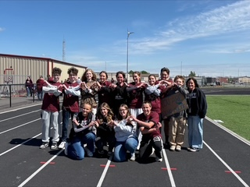
Our Mission:
A peer-to -peer suicide prevention program with a clear and impactful mission: to foster human connection, community and hope.

Slide 3
How we started:
1997: Dr. Greg Hudnall, then a high school principal in Provo, Utah, was contacted by police to help identify a student who had died by suicide. This tragic experience, along with a series of student suicides in the Provo City School District, motivated him to dedicate himself to preventing youth suicide.

Slide 4
History:
Early 2000s: Dr. Hudnall and his team observed that many young people considering suicide had given warning signs or spoken to friends, but these friends often didn't know how to respond or where to find help. This highlighted the need to empower peers to intervene and connect struggling individuals to adults who could provide support.
2004: Dr. Hudnall and his team started a pilot program, the first Hope Squad, at Timpview High School in Provo. This school was chosen due to its high rates of suicide threats, attempts, and completions. The program involved training students, nominated by their peers as trustworthy, to identify warning signs and refer struggling peers to adults.

Slide 5
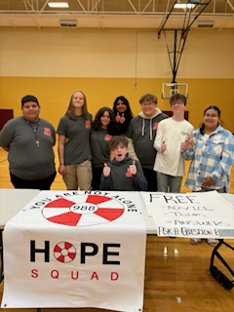
@ Rigby:
Hope Squad started at Rigby in 2021, after the administration decided to implement a mental health/suicide prevention program to be used district wide.
All schools in our district have a Hope Squad
We have not had one student suicide in that time period.

Slide 6
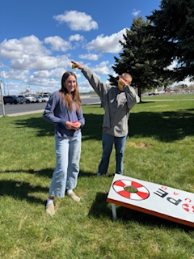
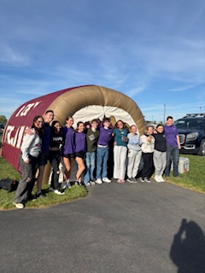
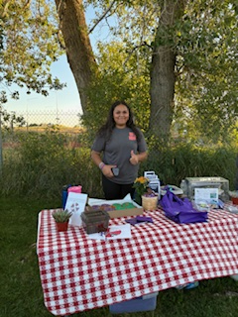

Slide 7

-Last year we started the year with 120 members
-Members nominated by their peers and teachers
-Class period every day – approximately 25 students each trimester.
-Each trimester= 1 big project

Slide 8
